Slide 1
Keeping Cows Pregnant Understanding and Managing Pregnancy Loss
Todd Meyer DVM

Slide 2
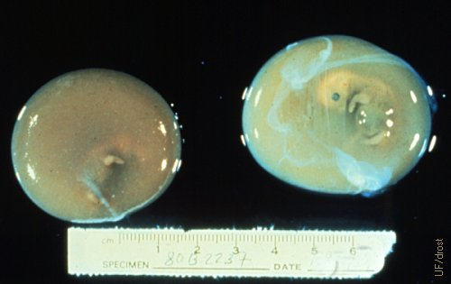
Pregnancy Loss in Perspective
50-day fetus-Drost Project
Evidence supports the fact that 80-90% of AI results in pregnancy (as defined by a fertilized oocyte)
By this definition, getting cows pregnant is not the key issue
Early pregnancy loss mostly occurs before current available methods can reliably detect pregnancy
Sporadic abortions of fetuses >90 days can be a distraction to roughly 50% of embryo loss that can occur before 1st pregnancy check
How can we explain the huge gap between heifer and mature cow fertility – P/AI, pregnancy loss, and twinning
Drost Project Photos- https://visgar.vetmed.ufl.edu/

Slide 3
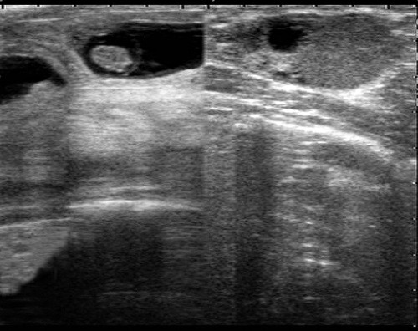
Phases of Early Pregnancy Loss
Estimates of early pregnancy loss depend on how loss is determined and phases are described
One framework- 4 Pivotal Periods (Wiltbank, Univ of Wisc)
First week after ovulation ~20-50% loss
8-27 days ~30% loss
28-60 days 11.7% loss (US average)
61-90 days ~2% loss
Estimates of early pregnancy loss (<28 days) are limited by the lack of commercially available and accurate test
Embryo quality and survival after implanted
ISG-15 (Interferon Stimulated Gene) – about 21 days
Early changes in PSP-B (Pregnancy Specific Protein B)
Progesterone levels at day 23 (not a specific indicator)
Drost Project

Slide 4
Review of existing studies – 46 research studies from 1996-2019
Before 19 days – not studied
Early Embryo (19-30 days) – 27% (Interferon Stimulated Gene-15, Progesterone)
Late Embryo (32-45 days) – 13% (Ultrasound, Pregnancy Associated Glycoproteins)
Early Fetus (45-60 days) – 7%
Late Fetus (60-90 days) – 2%

Slide 5
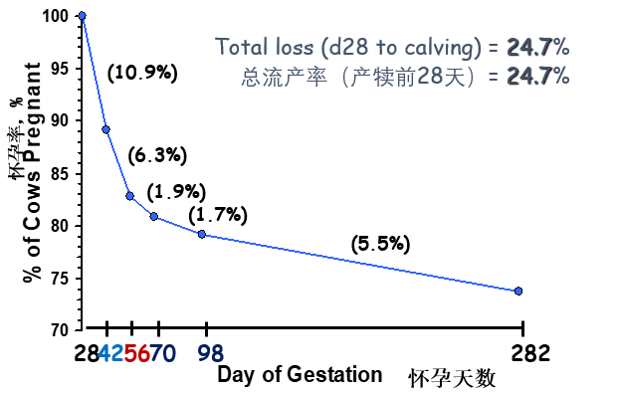
Pregnancy Loss from 28 Days
Early data on pregnancy loss in a herd over multiple periods
Timing of 1st pregnancy check is a major factor in documented losses
>56 days – rate slows down
Vasconcelos et al., 1997

Slide 6
True Abortion Rate
Date | Br Elig | Bred | Pct | Pg Elig | Preg | Pct | Aborts | % Abort
12/15/2015 | 272 | 149 | 55 | 270 | 64 | 24 | 7 | 10.9%
1/5/2016 | 263 | 162 | 62 | 260 | 62 | 24 | 3 | 4.8%
1/26/2016 | 270 | 131 | 49 | 269 | 50 | 19 | 7 | 14.0%
2/16/2016 | 262 | 167 | 64 | 257 | 64 | 25 | 2 | 3.1%
3/8/2016 | 307 | 150 | 49 | 305 | 58 | 19 | 4 | 6.9%
3/29/2016 | 323 | 187 | 58 | 318 | 76 | 24 | 7 | 9.2%
4/19/2016 | 347 | 170 | 49 | 343 | 70 | 20 | 6 | 8.6%
5/10/2016 | 347 | 198 | 57 | 345 | 74 | 21 | 5 | 6.8%
5/31/2016 | 369 | 187 | 51 | 364 | 73 | 20 | 7 | 9.6%
6/21/2016 | 370 | 194 | 52 | 360 | 65 | 18 | 6 | 9.2%
7/12/2016 | 398 | 220 | 55 | 393 | 74 | 19 | 6 | 8.1%
8/2/2016 | 374 | 201 | 54 | 371 | 67 | 18 | 7 | 10.4%
8/23/2016 | 395 | 234 | 59 | 389 | 70 | 18 | 6 | 8.6%
9/13/2016 | 406 | 202 | 50 | 404 | 70 | 17 | 8 | 11.4%
10/4/2016 | 389 | 249 | 64 | 384 | 92 | 24 | 9 | 9.8%
10/25/2016 | 369 | 201 | 54 | 364 | 79 | 22 | 4 | 5.1%
11/15/2016 | 338 | 211 | 62 | 333 | 79 | 24 | 11 | 13.9%
Total | 5799 | 3213 | 55 | 5729 | 1187 | 21 | 105 | 8.8%
12 months data beginning 20 months ago. All cows have completed pregnancies
Takes full account of all late pregnancy abortions
Typically higher by a few percentage points than current 21-d PR
Historical view that may not assist with new abortion problem
This data set is at lower end of normal range for 35 day pregnancy check

Slide 7
Abortion Incidence – Large Data Sets
 | A | B | C
#Pregnant | 20,146 | 28,392 | 50,653
Abort % | 16.1% | 16.1% | 33.3%
<60 d | 6.8 % | 4.1% | 14%
60-89 d | 3.8% | 4.2% | 11%
90-119 d | 1.3% | 3.3% | 3%
>119 d | 4.1% | 4.6% | 5%
Heifer Abort % | 10.0% | 9.5% | 9.1
One-year data sets of pregnancy that ended in either abortion or calving
A+B – Ultrasound or palpation at 34-42 d
C – Ultrasound or blood test at 28-30 d
Heifer abortions much lower

Slide 8
Abortion by Days Pregnant
A
Early detection or early incidence
B
Late detection or late incidence

Slide 9
Finding Patterns in Pregnancy Loss
Patterns in pregnancy loss should reflect timing of pregnancy checks and periods of higher risk
Good data quality is critical
Losses prior to 90 d are results of either:
Pregnancy confirmation results (Open Dx)
Return to estrus (AI and Abort event)
Visual signs of discharge/membranes
Fetuses typically not observed in early loss

Slide 10
Distribution of Abortions by Days Pregnant
Abortions are mostly in the first trimester of pregnancy, 90-100 days pregnant
Expect about 2/3 or more of abortions by then.
High late abortion numbers suggest a specific cause

Slide 11
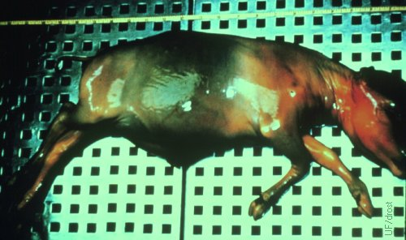
Abortions – What is the cause?
Drost Project
Many causes and often difficult to identify – rule out the common ones first
Infectious – Brucellois, BVD, IBR, Leptospirosis, Neospora, Mycosis, Listeriosis
Toxins – poisonous plants or weeds, mycotoxins, gossypol, poisonous plants (grazing)
Stress – heat, chronic or acute inflammation , nutritional, metabolic, handling and transportation
Hormonal/Reproductive Program – high production, synchronization, twinning

Slide 12
Survey of Aborted Fetuses – Yamini, AABP, 2004
1618 fetuses submitted to Michigan State Vet Lab for autopsy and analysis
More than 50% of fetuses reach no diagnosis
Infectious causes many are not specific and not useful to management interventions
数目
比例

Slide 13
Specific causes of abortion
数量 百分比
炎症(无病因)

Slide 14
Infectious abortions
Disease agent | Stage of pregnancy | Diagnostics | Prevention
Brucellosis | >5 months | Rose Bengal, FPA, Elisa | Vaccine, cull
BVD | Usually <90 days | Serology of dam, Persistent infection | Vaccine and remove PI
IBR | >4 months | Serology, histopathology | Vaccine
Leptospirosis | Usually >=6 months | Serology, Flourescent antibody of fetal kidney or dam urine | Vaccine, environmental (pasture) management
Listeriosis | About 7 months | Histopathology, culture | Often blamed on poor silage preservation
Mycotic | 3-7 months | Histopathology of placenta or fetus | No specific measures
Neospora | 3-8 months | Serology, histopathology | No contact with dogs

Slide 15
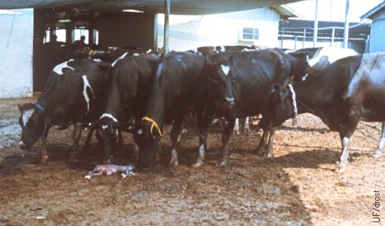
Infectious abortions
With the exception of BVD, most infections abortions are in mid to late pregnancy (>90 days)
Generally, if most abortions are diagnosed by the 90-day preg check the problem is less likely to be infectious
Infectious causes are often reported as non-specific inflammation, or as Arcanobacterium pyogenes (a secondary bacterial infection found in metritis and retained placenta).
Drost Project

Slide 16
Specimens for laboratory diagnosis of abortion
Samples of tissues for lab diagnosis
This is not widely available in China
Paired serum samples from dam – one at time of abortion and a second two weeks later
A steep rise in antibody titer to many infectious agents will suggest a recent infection

Slide 17
Effect of Gossypol on Fertility
Gossypol in cottonseed is associated with loss of fertility
Gossypol levels vary with varieties of cottonseed
Decrease in viability of early embryos and disrupt in hormone production in the ovary
Embryos from gossypol-fed heifers had lower pregnant rates at 28 and 42 days
Generally seen in high levels of cottonseed in ration (>15% DM) that exceed ability to detoxify in the rumen

Slide 18
Mycotoxins and Fertility
Aflatoxin is a potent immunosuppressive and can impact pregnancy at nearly any stage
Zearalenone has estrogenic properties that disrupt hormonal functions associated with embryo death
DON, T-2, Ergotamine and others
Direct fungal infections associated with late pregnancy abortions (6-8 m). Moldy feeds may contain Aspergillus or other molds
Avoid contaminated feeds and/or use commercial adsorbents to bind and neutralize

Slide 19
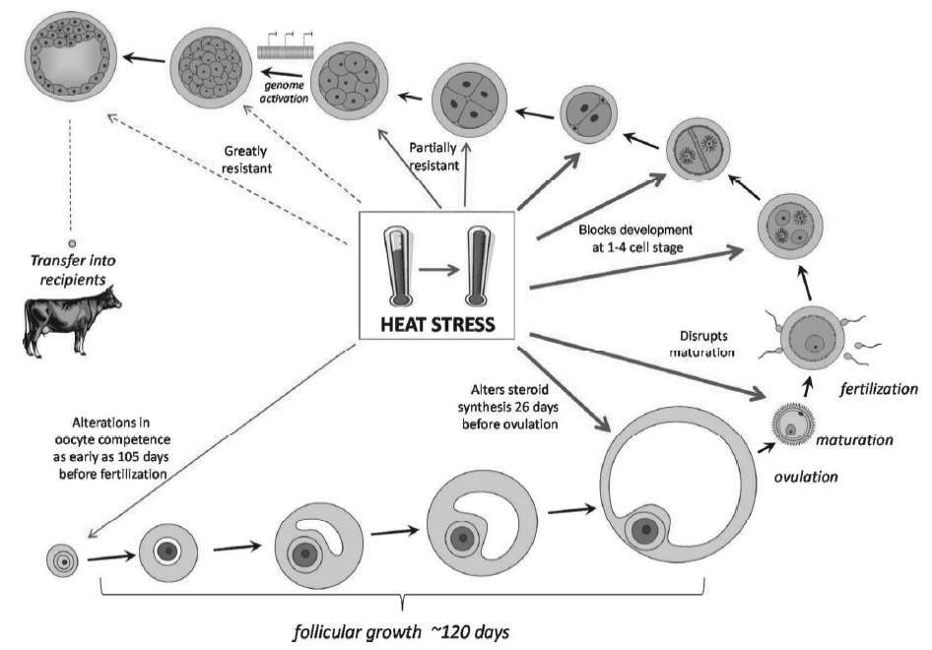
Overcoming Effects of Heat Stress with Embryos
Heat stress damage is a combination of severity and duration of exposure
Rectal temperature >39°C is best guess at the threshold for damage
Heat stress effect damages oocytes severely in last 42 days before ovulation
After ovulation the fertilized ovum is sensitive to acute heat stress for 2-3 days
Resistant to heat stress by day 5
Embryo transfer (day 6-8) can bypass heat stress sensitivity to oocyte and ovum
Source: Hansen, ADSA Large Herd Management Hdbk, 2017

Slide 20
Hormonal treatments to increase progesterone and improve P/AI
HCG, GnRH and CIDR all result in higher progesterone levels and potential benefits to reduce pregnancy loss
Mixed and inconsistent results to improve P/AI
Low body condition cows had significant response with CIDR – some support for CIDR-Sync TAI
Source: Hansen, ADSA Large Herd Management Hdbk, 2017

Slide 21
HCG and Pregnancy Loss
Human Chorionic Gonadotropin (HCG)
Effective drug to induce ovulation and subsequent accessory CL’s
Administered about 5 days post-AI
Progesterone from CL has been suggested as a means to support early pregnancy and reduce losses
Evidence is not convincing that this is a viable strategy under all situations
Effect has been reported to be more significant in heat stress
Insufficient evidence at this time for me to advise this application
Use may not be approved in some countries

Slide 22
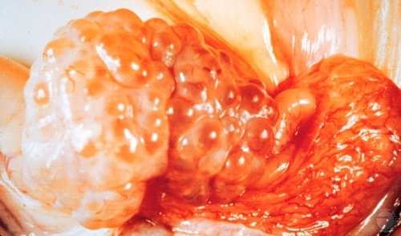
Induced Follicle Turnover in Autumn
Drost Project
Studies have been done to increase turnover of damaged follicles in the autumn (after heat stress ends)
This has been done with FSH or bST (bovine somatotropin) – may not be readily available or permitted in all countries
Two or three successive rounds of GnRH-PGF are also used to stimulate several follicular waves
Not backed up with sufficient data from my research

Slide 23
Fat Nutrition and Reproduction
Linolenic N-3 Fatty Acid – polyunsaturated fat
Positive impact on fertility – reduced pregnancy loss, improved oocyte quality and CL function
All studies cited showed numerical reduction in pregnancy loss
Supplemental fat at 1.5% of DM with high levels of N-3 (and N-6) FA is recommended – consult your nutritionist (not me!) for detailed guidance
Source: Santos, ADSA Large Herd Management Hdbk, 2017

Slide 24
Explaining Low Fertility of Cows vs Heifers
Heifer fertility outcomes greatly exceed mature cows – higher P/AI, lower pregnancy loss, fewer twins
Heifer P/AI% has been 60-65% since 1950’s
US data mature cow P/AI% for was 34% as recent as 2011
With use of effective pre-synchronization increased to 47% by 2019 (Fricke, et al, 2025)
E2-Estrogen P4-Progesterone
Fricke and Wiltbank, JDS, 2022

Slide 25
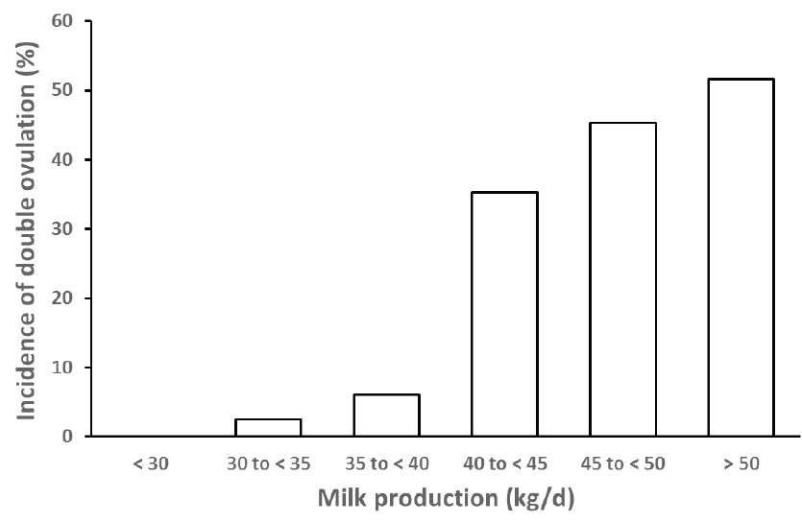
Milk Production, Twins and Pregnancy Loss
 | All | Single | Twins
Pregnant at 36d | 1442 | 1310 | 132
Abort by 90d | 139 (9.6%) | 101 (7.7%) | 38 (28.8%)
1,442 pregnancies weekly U/S from 36-90 days pregnant
Twin pregnancies 3X more likely to abort than single from 36-90 days after AI
Twin unilateral pregnancy 2-3X more likely to abort than bilateral (both horns)
High twinning rates associated with high milk production (>40 kg) previous 14 days to breeding
Fricke, AABP, 2015 from Lopez, Theriogenology, 2005
Lopez-Gatius, ReprDomAn, 2004

Slide 26
Role of hormonal environment on pregnancy loss
Cows pre-synchronized (G-7-G) and given 1st GnRH of Ovsynch on day 7 of cycle
PGF2α and CIDR used to create high(H) or low(L) progesterone environment for early and late follicle development in 7 day period between GnRH and PGF2α – 4 groups H/H, H/L, L/H, L/L
Measured outcomes – Ovulations single and double, P/AI, pregnancy loss by stage, twin pregnancies by horn, calvings, twin births

Slide 27
Successful Ovysynch Improves Pregnancy Outcomes
The success of the 1st GnRH is critical to establishing a functional CL and high progesterone level until PGF on day 7
Failure to have a stable high progesterone level alters follicle maturation and results in double ovulations and twins
Double ovulations have a high %P/AI at 23 day after breeding – 73% vs 51%
Unilateral pregnancies have high rate of abortion at 35-56 days after breeding – 39% versus 21% in single ovulation pregnancies
All twins that survive to calving create risk for the cow post-calving and loss of fertility to females of mixed male-female twins

Slide 28
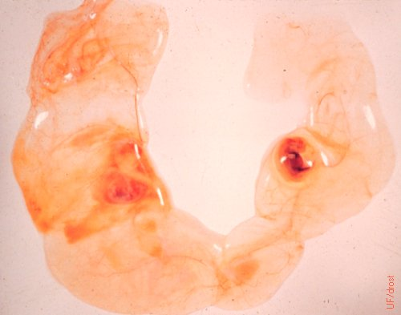
Reducing Pregnancy Loss from Twins
Unilateral twins - Drost
Most effective means to reduce twinning is to emphasize effective pre-synchronization in TAI (timed AI) programs
Follow protocols that result in high ovulation rates to 1st GnRH
Ovulatory follicle matures under high progesterone
Insure complete luteolysis at day 7 of Ovsynch with PGF2α, with option to add 2nd PGF2α on day 8
Results in fewer double ovulations, fewer twins, less pregnancy loss
Manual rupture of the amnion of one embryo in unilateral twins and CIDR for 21-28 days has been studied, but not routinely in use

Slide 29
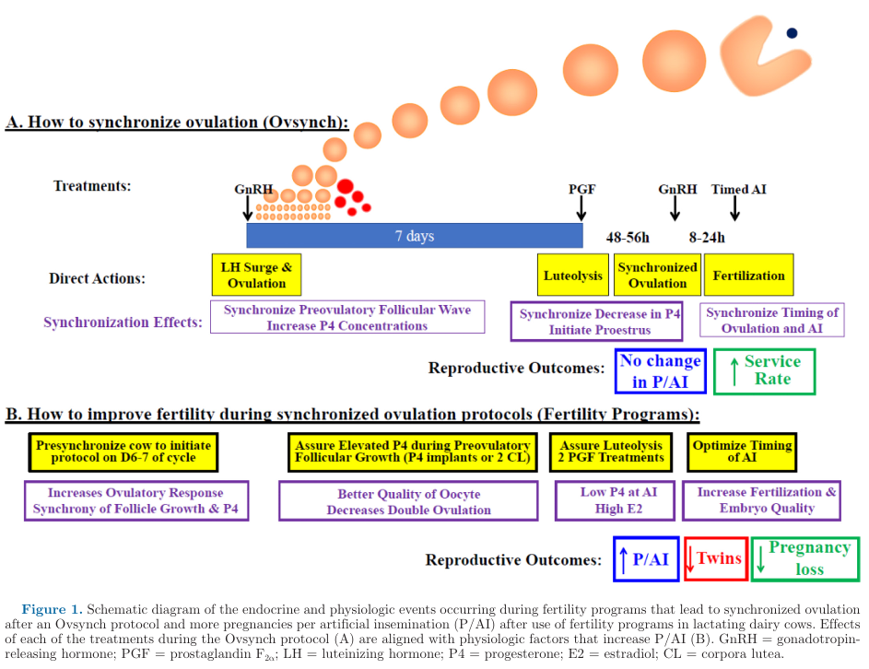
30 years of Progress!
Ovsynch-TAI Protocol
Effective tool for increasing insemination rate – all cows get bred
1st GnRH on random day of cycle – about 50% response
%P/AI no improvement over estrus detection and AI
Fertility programs
Rely on Presynchronization before start of Ovsynch at day 6-7 of cycle
Optimal outcomes for fertility
Higher %P/AI
Fewer twins
Less pregnancy loss
Fricke and Wiltbank, JDS, 2022

Slide 30
In 2010 We Asked: Can High Producing Cows Be Healthy?
Thought Provoking Concept
High Production and High Health
30/30 Club
30,000 lbs milk/yr (13,600 kg)
30% cull rate or lower
24 Wisconsin top dairies to demonstrate that high production and high health performance are achievable
…but, 21-d PR average = 18%
Low PR reflects the wasted potential of the cow’s reproductive capacity
 | Average
Herd Size | 488 cows
Milk/cow | 14,300 kg
Cull Rate | 33%
SCC | 191,000
21-d PR | 18
Cook, AABP Proc., 2010

Slide 31
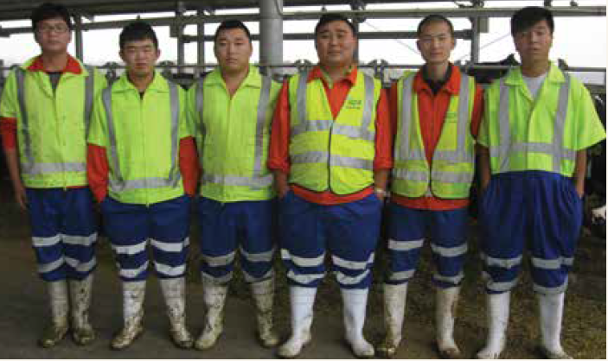
Closing Remarks
What your breeding team needs from you to get results
Up-to-date and science-based protocols that fit your farm system
Support with the tools for success
Training on basic AI procedures, semen handling, cow handling, etc..
Facilities that encourage efficient and stress-free handling for staff and cows
Advanced tools for greater efficiency, accuracy- U/S, PAG, E-Monitors,..
Healthy, stress-free cows with high genetic potential
Incentive systems that reward staff for achieving what is within their control

Slide 32
Closing Remarks
The best proxy for the reproductive potential of a mature cow is our heifers – we should strive to further close the gap on performance
This requires an all-farm approach with breeders contributing the final steps in achieving this goal – fertility is more than just the AI gun
Deep analysis of farm performance guided by academic and expert advice can reveal the bottlenecks constraining cow genetic potential
Managing cows using averages of key metrics ignores the exceptions where opportunity lies
More often than not the bottlenecks are created at the highest levels of management
Barn design, cow comfort, ventilation and cooling, feeds and feeding,…
Own the problem, make a plan, and open up the bottlenecks
Better performance is within our reach!

Slide 33
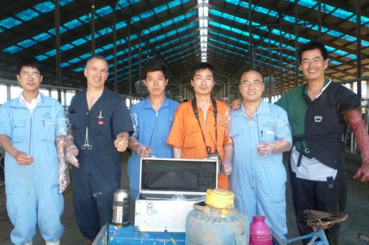
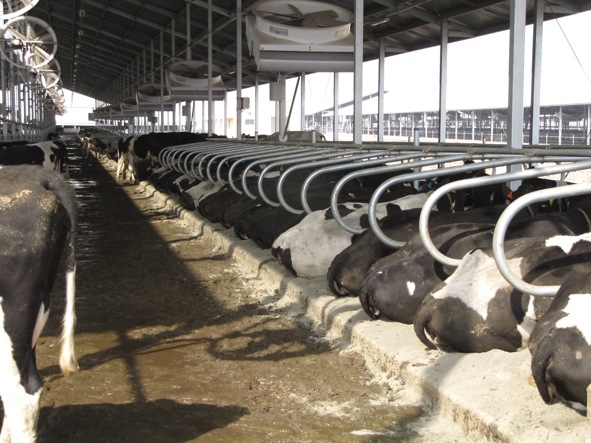
Thank you Questions?
Todd Meyer DVM
tmmbeijing@yahoo.com

